Slide 1
Regression Models
Data Science & Business Analytics
Lesson 4

Slide 2

Lesson Plan
Explain what is regression
Present 6 most common algorithms
How to transform a regression problem into a classification model
Example
Explain is unsupervised Learning
Explain most common algorithms
Example

Slide 3
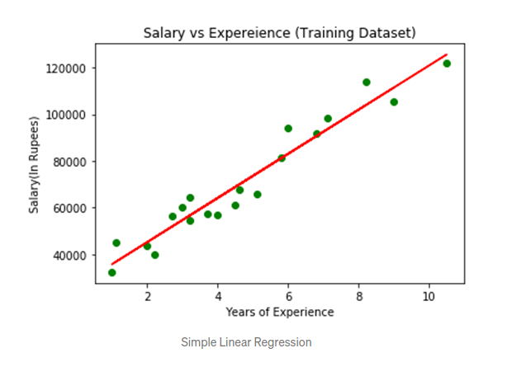
Linear Regression
In regression model the idea is to predict continuous data. For example the age, or salary of someone.
The formula is simple linear regression is y = m x +c.
Like other models, you can analyse how good it is. In this example this is done by calculating the error (next slide)
In python
from sklearn.linear_model import LinearRegression
regressor = LinearRegression()
regressor.fit(X_train, y_train)

Slide 4
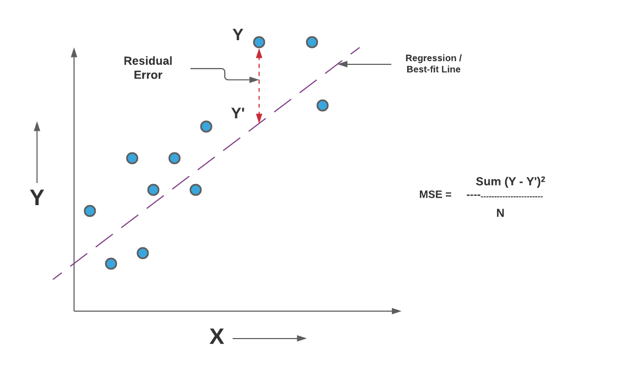
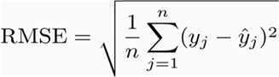
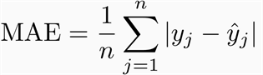
Regression error
The most common is the MSE (Mean Square error). Represented in the picture in the right.
Other errors are:
Root Mean Squared Error
from sklearn.metrics import mean_squared_error
Mean Absolute Error
from sklearn.metrics import mean_absolute_error

Slide 5
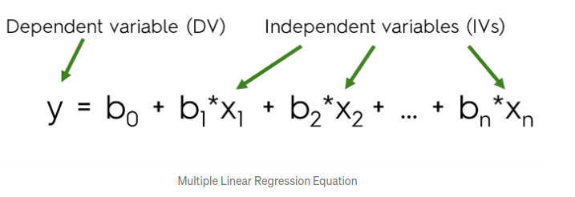
Multiple Linear Regression
This is very similar to the one dependent variable linear regression, but generalized to multiple variables.
from sklearn.linear_model import LinearRegression
regressor = LinearRegression()
regressor.fit(X_train, y_train)

Slide 6
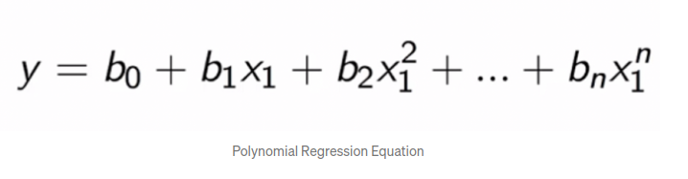
Polynomial Regression
from sklearn.preprocessing import PolynomialFeatures
poly_reg = PolynomialFeatures(degree = 3)
X_poly = poly_reg.fit_transform(X)
lin_reg = LinearRegression()
lin_reg.fit(X_poly, y)

Slide 7
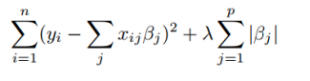
Lasso Regression
The purpose of lasso and ridge is to stabilize the vanilla linear regression and make it more robust against outliers, overfitting, and more.
Lasso regression is a type of linear regression that uses shrinkage. Shrinkage is where data values are shrunk towards a central point, like the mean. The lasso procedure encourages simple, sparse models (i.e. models with fewer parameters). This particular type of regression is well-suited for models showing high levels of multicollinearity or when you want to automate certain parts of model selection, like variable selection/parameter elimination.
Lasso regression performs L1 regularization, which adds a penalty equal to the absolute value of the magnitude of coefficients.
When λ = 0, no parameters are eliminated. The estimate is equal to the one found with linear regression.
As λ increases, more and more coefficients are set to zero and eliminated (theoretically, when λ = ∞, all coefficients are eliminated).
As λ increases, bias increases.
As λ decreases, variance increases.
https://www.statisticshowto.com/lasso-regression/#:~:text=Lasso%20regression%20is%20a%20type,i.e.%20models%20with%20fewer%20parameters).

Slide 8
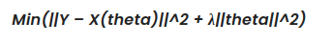
Ridge Regression
Least squares regression isn’t defined at all when the number of predictors exceeds the number of observations; It doesn’t differentiate “important” from “less-important” predictors in a model, so it includes all of them. This leads to overfitting a model and failure to find unique solutions. Least squares also has issues dealing with multicollinearity in data.
Ridge regression belongs a class of regression tools that use L2 regularization.
L2 regularization adds an L2 penalty, which equals the square of the magnitude of coefficients. All coefficients are shrunk by the same factor (so none are eliminated). Unlike L1 regularization, L2 will not result in sparse models.
The bias increases as λ increases.
The variance decreases as λ increases.
https://www.statisticshowto.com/lasso-regression/#:~:text=Lasso%20regression%20is%20a%20type,i.e.%20models%20with%20fewer%20parameters).

Slide 9
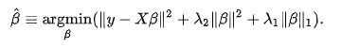
Elastic Net
Elastic Net implements both Lasso and Ridge Regression so both L1 and L2 can be choose independently.
https://www.statisticshowto.com/lasso-regression/#:~:text=Lasso%20regression%20is%20a%20type,i.e.%20models%20with%20fewer%20parameters).

Slide 10
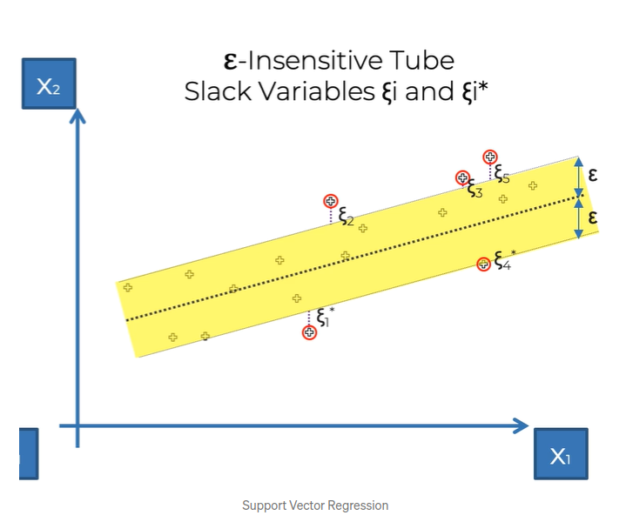
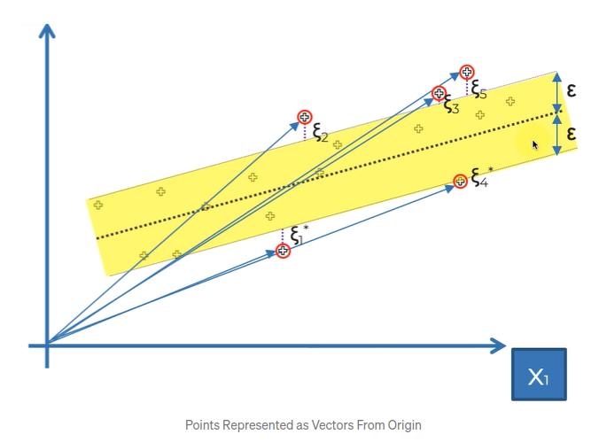
Support Vector Regression
In the Support Vector Regression Model, we have an Ɛ-tube of width Ɛ and a regression line in the middle of this tube. Our goal is to draw a line such that the sum of squared errors is minimized.
The errors are calculated by measuring the distance of points lying outside the tube from the closest point on the tube. The name Support Vector Regression comes from the fact that all points can be represented as vectors starting from the origin.
https://www.youtube.com/watch?v=-EjQWqHMsog&ab_channel=Iknowpython
https://www.youtube.com/watch?v=efR1C6CvhmE&ab_channel=StatQuestwithJoshStarmer
from sklearn.svm import SVR
regressor = SVR(kernel = 'rbf')
regressor.fit(X, y)

Slide 11
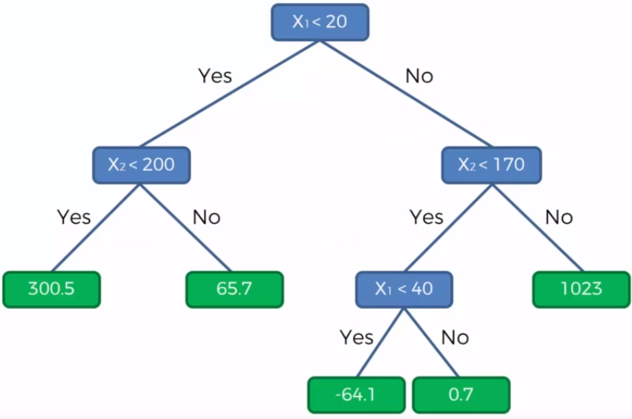
Decision Tree Regression
This same of Decision tree classification. But in this use case the output is the continuous variable.
from sklearn.tree import DecisionTreeRegressor
regressor = DecisionTreeRegressor(random_state = 0)
regressor.fit(X, y)

Slide 12
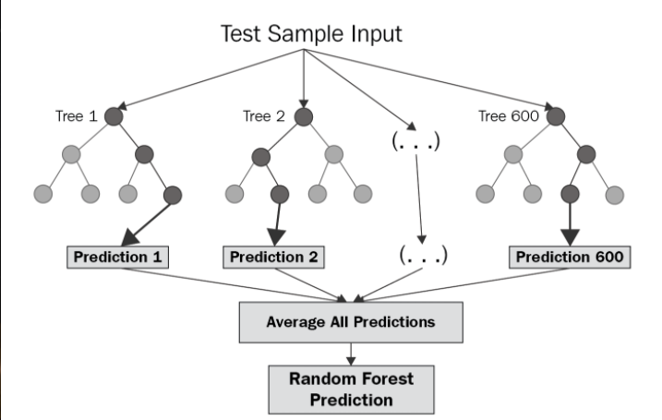
Random Forest Regression
from sklearn.ensemble import RandomForestRegressor
regressor = RandomForestRegressor(n_estimators = 10,random_state= 0)
regressor.fit(X, y)

Slide 13
Let’s practice
Load Boston housing prices dataset
EDA
Check for outliers in the data
Remove them if needed
Let’s compute correlation between features and predict label
Apply MinMax scaler to the dataset
Plot each feature against the predict label and plot a linear regression just for viz purposes
Check data skewness, and remove if bigger than 0.3
Let’s apply the following models: linear regression, Lasso Regression, Ridge Regression, ElasticNet, DecisionTreeRegressor and SVR
Apply a 10 fold validation.

Slide 14
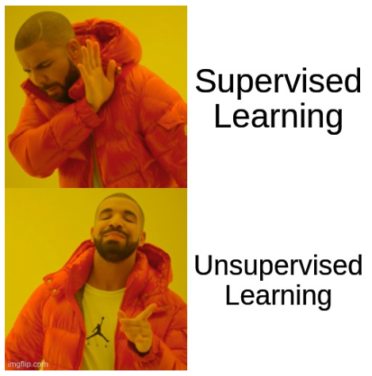
Unsupervised learning
In this kinds of models, the predict label is not provided, so the model works by trying to group the features considering the similarity. The goal is still to understand the underlying data distribution.
Unsupervised can be divided into:
Clustering: Divide data into groups . For example, group cars by type
Algo: K-means
Association: The idea here is to find the rules that describe large portions of data.
Apriori algorithm association
A third use case is to use unsupervised algorithms to reduce the number of dimensions in the data.
Not scope of the course

Slide 15
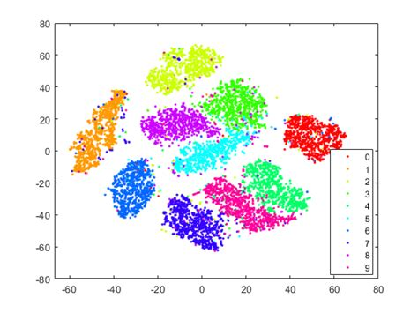
Dimensionality reduction
This technique is sometimes necessary when the number of features i.e. number of columns is very large. This create very sparse matrices that make training very hard and slow. Also is very difficult to find a good solution.
This is called “Dimensionality curse”
How the right, you can see what this looks like when we apply a tsne technique.
Another popular technique is PCA (Principal component analysis)
But there are many many more https://towardsdatascience.com/11-dimensionality-reduction-techniques-you-should-know-in-2021-dcb9500d388b

Slide 16
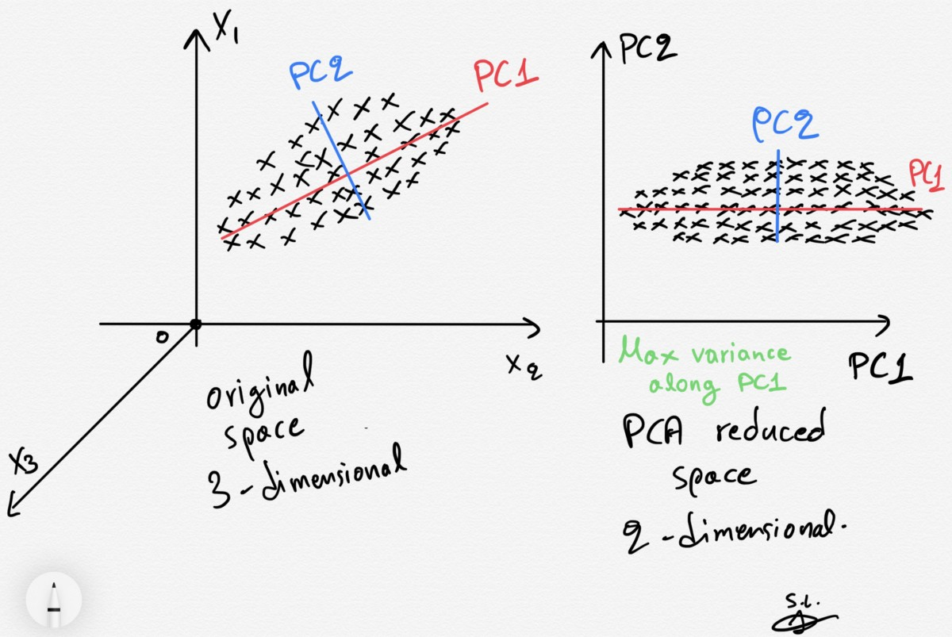
PCA
In this algorithm we search for the direction that have the highest variance. And after that, we project the data, in the subspace of highest variance.
To find those direction we use the eigenvectors, that we say in the first lecture. And the magnitude is compute using the eigenvalues.
5 MIN EXPLANANTION https://www.youtube.com/watch?v=HMOI_lkzW08&ab_channel=StatQuestwithJoshStarmer

Slide 17
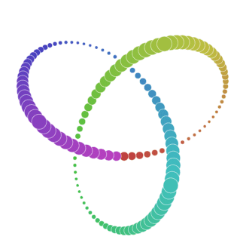
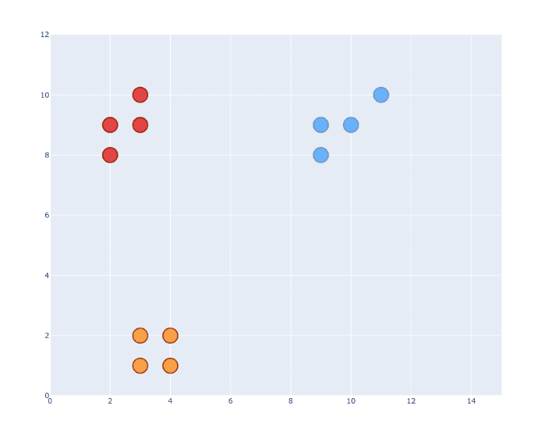
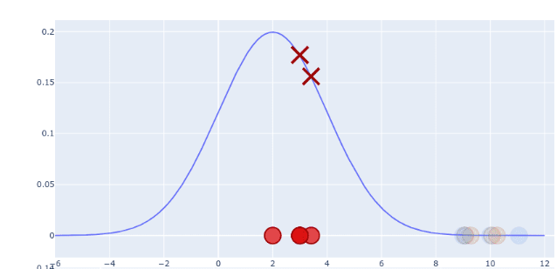
T-SNE
LIke PCA the idea is to reduce the number of features. It was developed by Laurens van der Maaten and Geoffrey Hinton in 2008.
T-SNE is important because it works in data that is not separable by linear methods like PCA.
The base idea is to define the probability definition that mimics each group.
More info here https://towardsdatascience.com/t-sne-clearly-explained-d84c537f53a

Slide 18
PCA (Exercise)
Load iris dataset from url = "https://archive.ics.uci.edu/ml/machine-learning-databases/iris/iris.data"
Apply normalization into the data
Extract two components using
from sklearn.decomposition import PCA
pca = PCA(n_components=2)
Plot each component and the respectful labels
Check explained variance using pca.explained_variance_ratio_
How to choose number of PC?
Choose by selection the sum of explained variance. Ideally should be higher than 90%

Slide 19
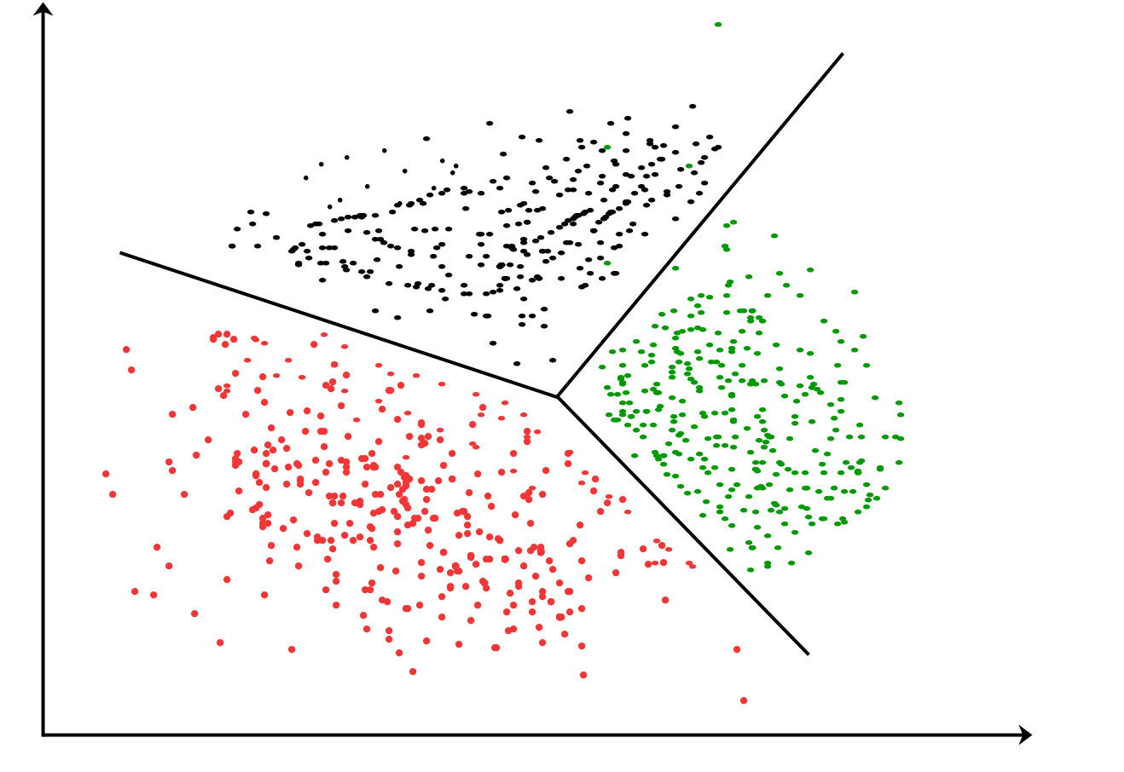
Clustering
Clustering methods consist of the separation of the data by the similarity of the data.
The are plenty of methods, in this course we will cover:
K-means
There may exist use cases where we even do not know what to expect from the clusters.
There was one use case I did in Stratio, were the states meant machine working behavior patterns.

Slide 20
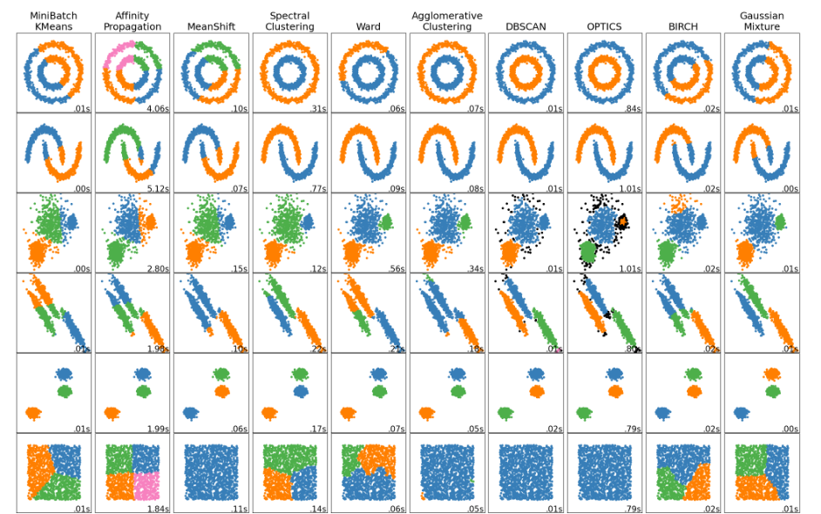
Clustering

Slide 21
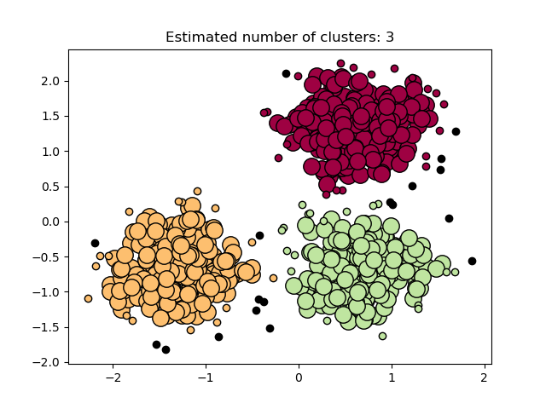
Density-Based Clustering
In this method, the clusters are created based upon the density of the data points which are represented in the data space. The regions that become dense due to the huge number of data points residing in that region are considered as clusters.
The data points in the sparse region (the region where the data points are very less) are considered as noise or outliers. The clusters created in these methods can be of arbitrary shape.
Example: DBSCAN

Slide 22
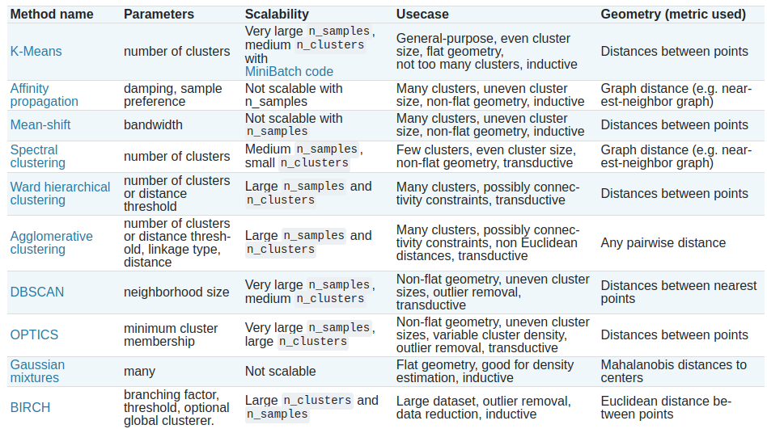
Models

Slide 23
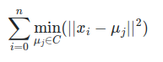
Partition methods - K-means
The K-Means algorithm clusters data by trying to separate samples in n groups of equal variance, minimizing a criterion known as the inertia or within-cluster sum-of-squares (see below). This algorithm requires the number of clusters to be specified. It scales well to large number of samples and has been used across a large range of application areas in many different fields.
The k-means algorithm divides a set of N samples X into K disjoint clusters , each described by the mean of the samples in the cluster. The means are commonly called the cluster “centroids”; note that they are not, in general, points from X , although they live in the same space.
The K-means algorithm aims to choose centroids that minimise the inertia, or within-cluster sum-of-squares criterion:

Slide 24
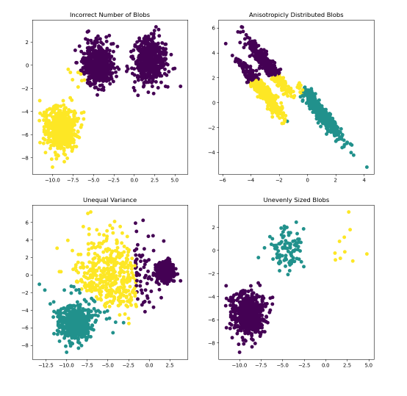
K-means drawbacks
Inertia makes the assumption that clusters are convex and isotropic, which is not always the case. It responds poorly to elongated clusters, or manifolds with irregular shapes.
Inertia is not a normalized metric: we just know that lower values are better and zero is optimal. But in very high-dimensional spaces, Euclidean distances tend to become inflated (this is an instance of the so-called “curse of dimensionality”). Running a dimensionality reduction algorithm such as Principal component analysis (PCA) prior to k-means clustering can alleviate this problem and speed up the computations.

Slide 25
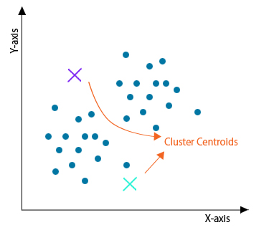
K-Means - Step 1
When we are starting off the algorithm, we randomly assign the number of desired centroids in the data space. Bear in mind that the location of the centroids can be different, depending on the method utilized.
The only constraint to have in mind is the number of data point.s The number of clusters cannot be bigger.

Slide 26
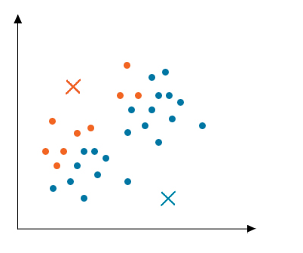
K-Means - Step 2
In this step, data is divided based on the distance between each point to the centroid. The goal is to minimize that distance.

Slide 27
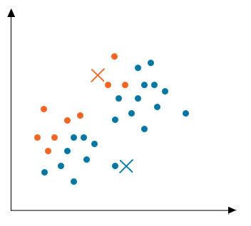
K-Means - Step 3
Once we divide the data, we update the location of the centroid. Normally a average is computed.

Slide 28
Why K-means?
Below are the disadvantages mentioned:
Needs prior specification for the number of cluster centers
If there are two highly overlapping data, then it cannot be distinguished and cannot tell that there are two clusters
With the different representations of the data, the results achieved are also different
Euclidean distance can unequally weigh the factors
It gives the local optima of the squared error function
Sometimes choosing the centroids randomly cannot give fruitful results
It can be used only if the meaning is defined
Cannot handle outliers and noisy data
Do not work for the non-linear data set
Lacks consistency
Sensitive to scale
If very large data sets are encountered, then the computer may crash.
Prediction issues
Below are the advantages mentioned:
It is fast
Robust
Easy to understand
Comparatively efficient
If data sets are distinct, then gives the best results
Produce tighter clusters
When centroids are recomputed, the cluster changes.
Flexible
Easy to interpret
Better computational cost
Enhances Accuracy
Works better with spherical clusters

Slide 29
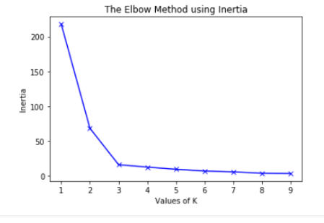
How to choose a clustering model
The technique is called elbow method. Because it looks like an elbow :=
The idea is to iterate over several different values of k, and check when the increase in cluster no longer helps.

Slide 30
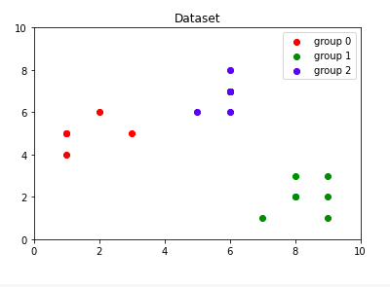
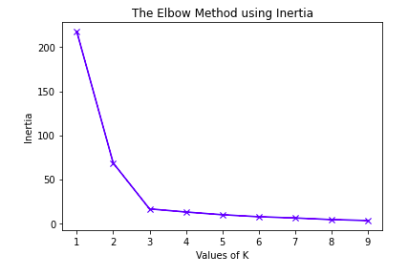
Example of application
https://colab.research.google.com/drive/1EE0THCPBFYxNFnLN8a6QR5DTcXA1GB3i?usp=sharing

Slide 31
Clustering exercise
Load car dataset
EDA (show feature histogram)
Fill missing values if needed
Plot T-SNE
Plot elbow chart
Choose n of cluster
Plot with different clusters and compare
Plot results

